Slide 1
ELK installation

Slide 2
Requirements
User intranet
Chef workstation access ??
ADM account (privileged access)

Slide 3
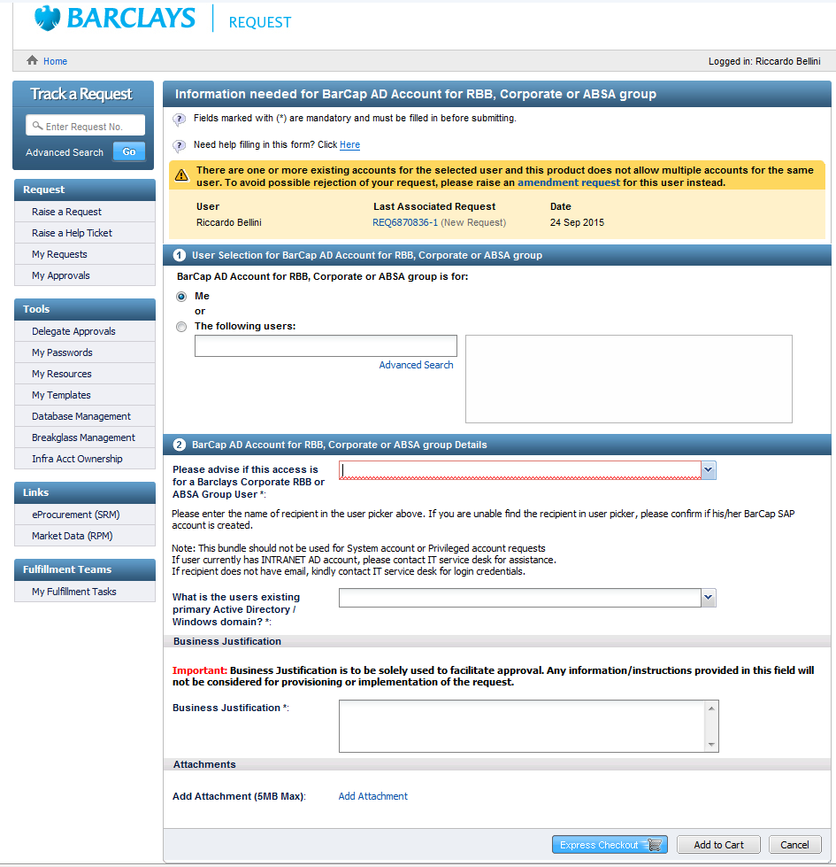
Request for intranet account

Slide 4
Main Points
Provisioning Server
Configuration of ELK

Slide 5
Bob_ID – You need to be a requester on bcloud
Lunux group – this needs to be added to the bob_ID
Powerbroke to the system account
Create a repository for ELK using pipeline
Write a wrapper cookbook
Test it
Push it to development branch
Push it to production

Slide 6
Project Request
Create ELK repo using pipeline
On-board
Create wrapper cookbook
Test it
Push to Development branch
PowerBroke to system account
Push to production
Bcloud provisioning

Slide 7
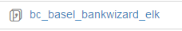
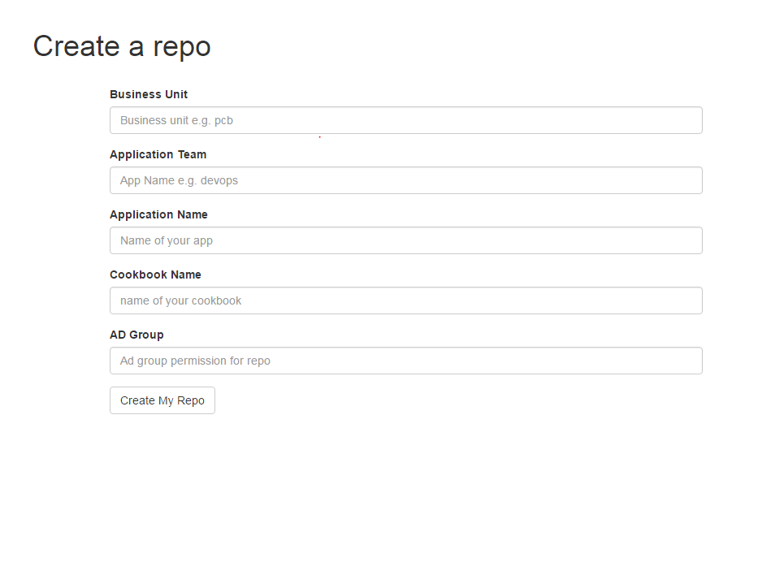
Create a repository for ELK using pipeline
Business unit
application name
Create a cookbook repo on stash using this link: http://gbrpsr000001929.intranet.barcapint.com/repo
That link will take you to a page with this form on (image on the bottom right)
It is important to log into stash using your intranet account.
This would then create a cookbook under this project:
https://stash.barcapint.com:8443/projects/IS_CHEF_CKBKS /cookbook_name
application team
Cookbook
Notes:
Intranet account is mapped to AD group
Username and group change

Slide 8
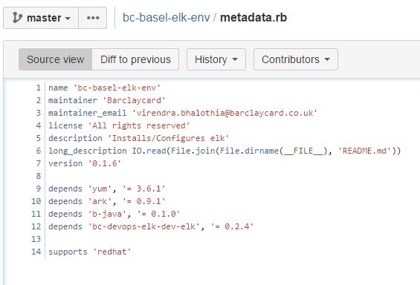
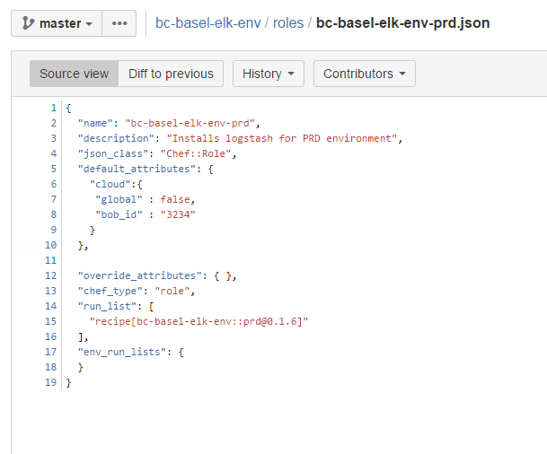
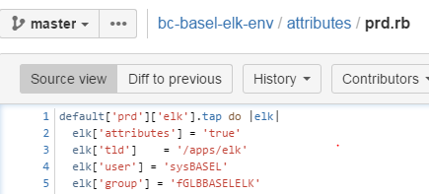
Write a wrapper cookbook
Example - https://stash.barcapint.com:8443/projects/IS_CHEF_CKBKS/repos/bc-basel-elk-env/browse
Above has an example of a wrapper cookbook
Make sure you change the username and group on each wrapper cookbook in attributes/prod.rb
Each wrapper cookbook has to require the main ELK cookbook in the metadata.rb
cvcv
BOB_ID provided by config manager

Slide 9
Test it
Test the wrapper cookbook locally using test-kitchen
Notes:
master

Slide 10
Push it to chef-server
Then you will need to use the automated pipeline in order to push the cookbook to the chef-server
The cookbook will be available for non_prod environments
but requires a CR for prod environments
All the information you need to know about the cookbook development workflow: https://confluence.barcapint.com/display/CHEFPL01/Cookbook+Development+Workflow
above link will give you a step by step instructions on how to create a cookbook, develop your cookbook, test it and then submit your cookbook to the pipeline.

Slide 11
Push it to production
The git push to development branch would create a job under this project in Jenkins: http://gbrpsr000001929.intranet.barcapint.com:8080/job/cookbook-pipeline-is_chef_ckbks/

Slide 12
Bcloud portal
Once the cookbook is pushed along with the role
Go to the bcloud portal and provision the server along with the role you have pushed.
How does it know what cookbook to use?
Global roles for everyone
Private roles is for specific bob id

Slide 13
On-Boarding & Creating AD groups
Firstly you need to either find the application in servicenow or create the application if it does not exist.
If you are creating the application it will then need to be authorized/ approved from service manager (config manager will complete task).
You need to create 4 functional AD groups: (example on 13th slide)
Requester group
Privileged group
Below includes request link for ad group creation
Non-Privileged access group
Linux access group
http://request.barcapint.com/FormAction.do?method=submitProduct&type=emptyForm&ID=H990024094
Need project OBN. (This is required for billing purposes)

Slide 14
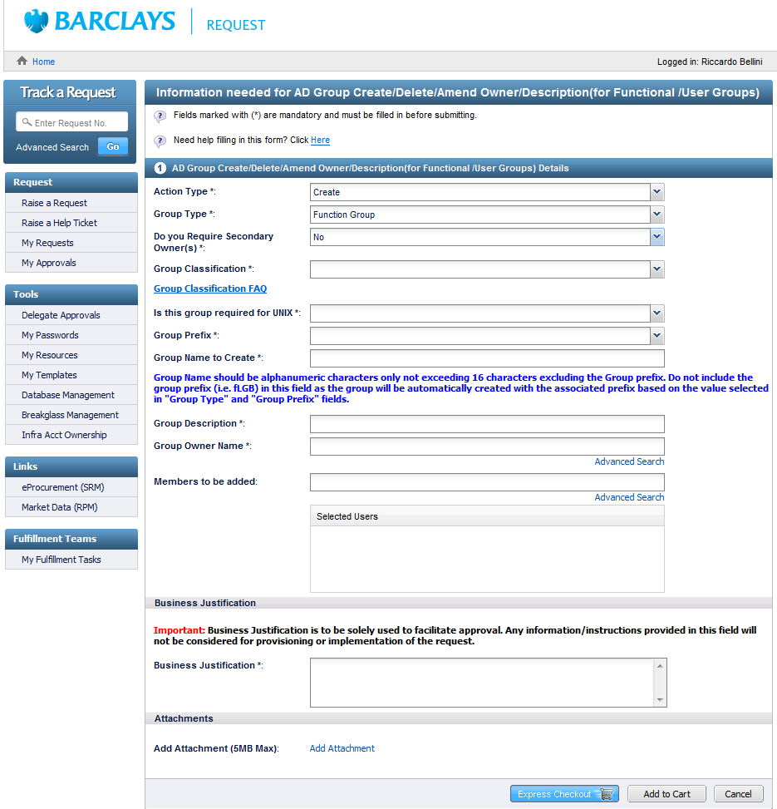
AD group request form
This is the request for creating an AD group

Slide 15
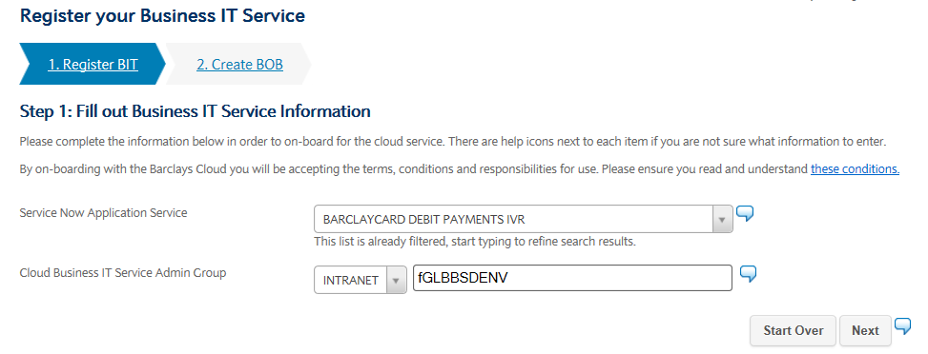
On-boarding process (Config management task)

Slide 16
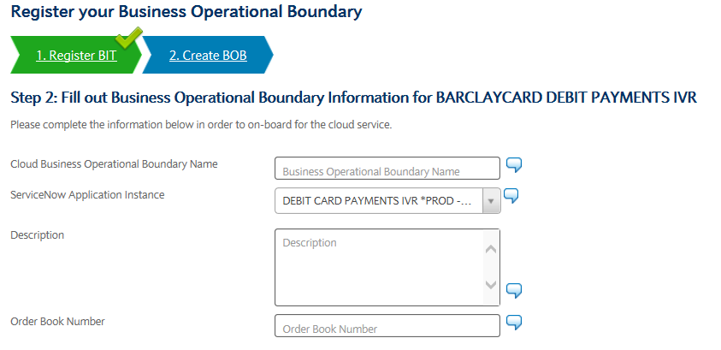
On-boarding process (Config management task)

Slide 17
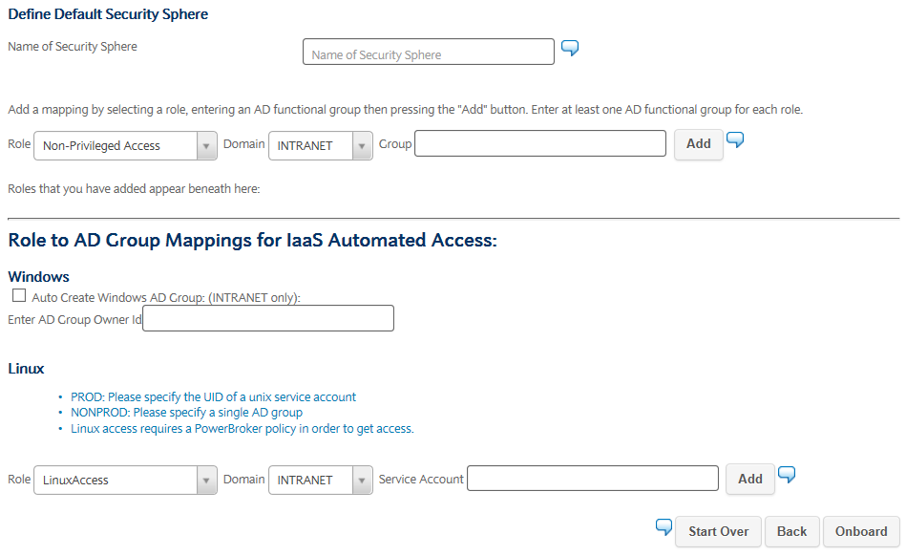
On-boarding process (Config management task)

Slide 18
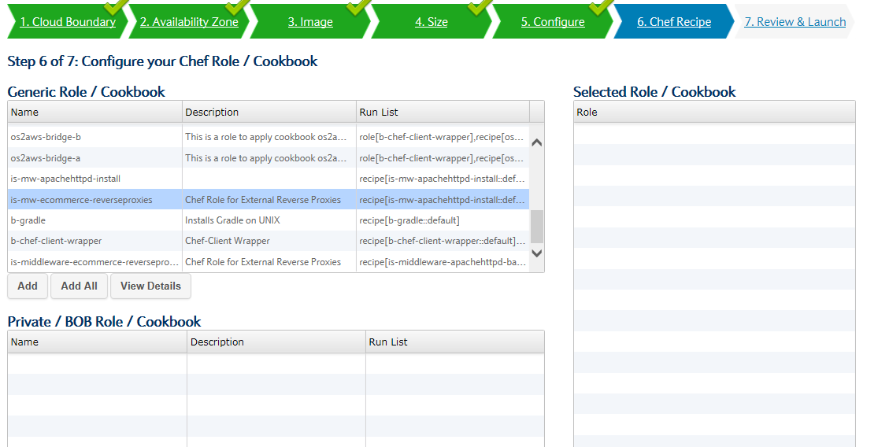
Generic roles for general cookbooks Private roles are for specific BOB ID cookbooks

Slide 19
BOB ID – You need to be a requester for bcloud
On boarding creates the BOB ID
Chef scripts cookbooks
Go back in cloud to provision server

Slide 20
Linux group – this needs to be added to the BOB ID
Iaas instance
Goal VM machine
You need an application in service now
Find if application already exists in service now
Need to create it if doesn’t
Needs approval from service manager
Servicenow tasks to be completed by config team:
4 AD groups created
Requester group
Privileged access group
Non-Privileged access group
Linux access
Config manager will onboard application this will provide BOB ID
BOB ID is used in bcloud portal

Slide 21
